Slide 1
Ultrafast Nonlinear Plasmon Decay Processes in Silver Nanoclusters
Gowri Kuda-Singappulige
Adviser: Christine Aikens
VISTA Seminar 15 03/31/2021

Slide 2
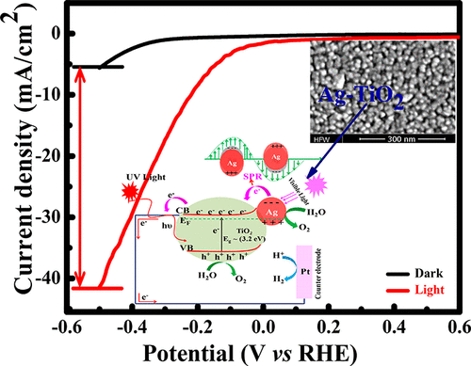
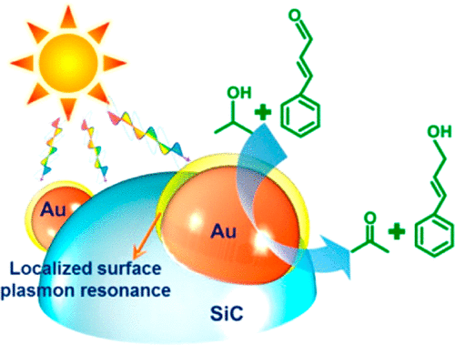
Plasmonic nanostructures for light-induced processes
Enhanced Solar Energy Conversion
Plasmon-Induced Selective Catalysis
dark
Visible Light
light
ACS Appl. Energy Mater. 2020, 3, 2, 1821-1830
J. Am. Chem. Soc. 2016, 138, 30, 9361–9364
Notes:
hybrid nanostructure consisting of a plasmonic metal nanocrystal and a semiconductor with overlapping absorption and plasmon resonance energies
Plasmon-induced selective hydrogenation of cinnamaldehyde to cinnamyl alcohol in the presence of 2-propanol over Au/SiC heterostructures. The hot electrons and steric effects at the interface facilitate the activation of α,β-unsaturated aldehydes to unsaturated alcohols.

Slide 3
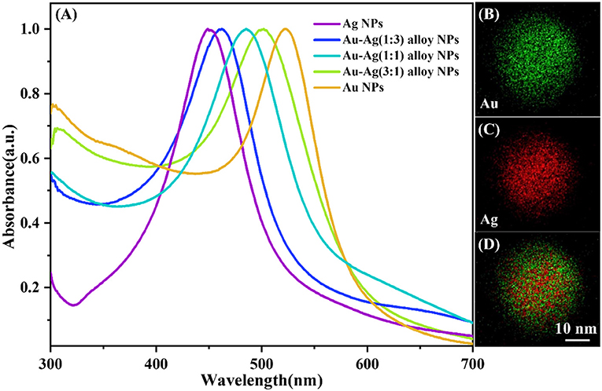
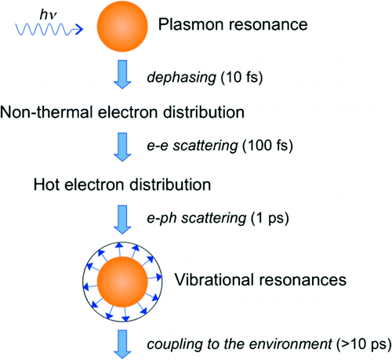
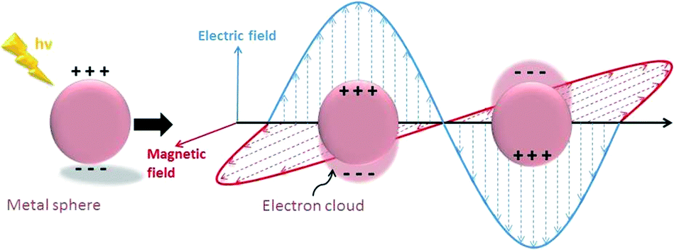
INTRODUCTION
Plasmon Resonance
Rapid plasmon decay:
A challenge for practical applications
Plasmon decay processes
Front. Chem. 2019, 7, 647-647
Catal. Sci. Technol., 2016, 6, 320-338
Chem. Rev. 2011, 111, 6, 3858–3887

Slide 4
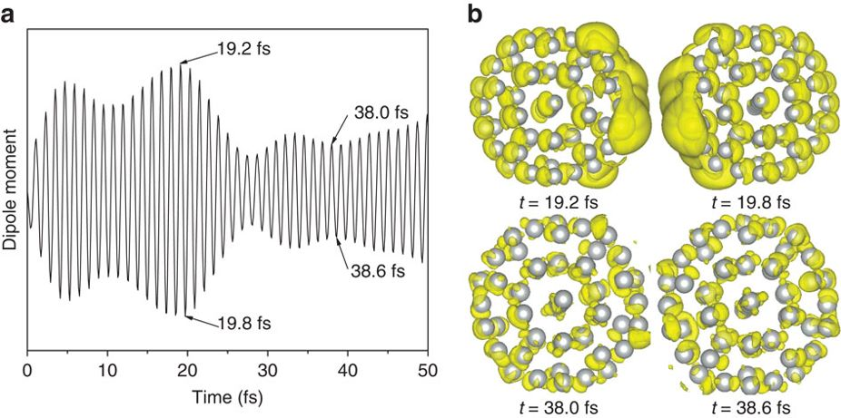
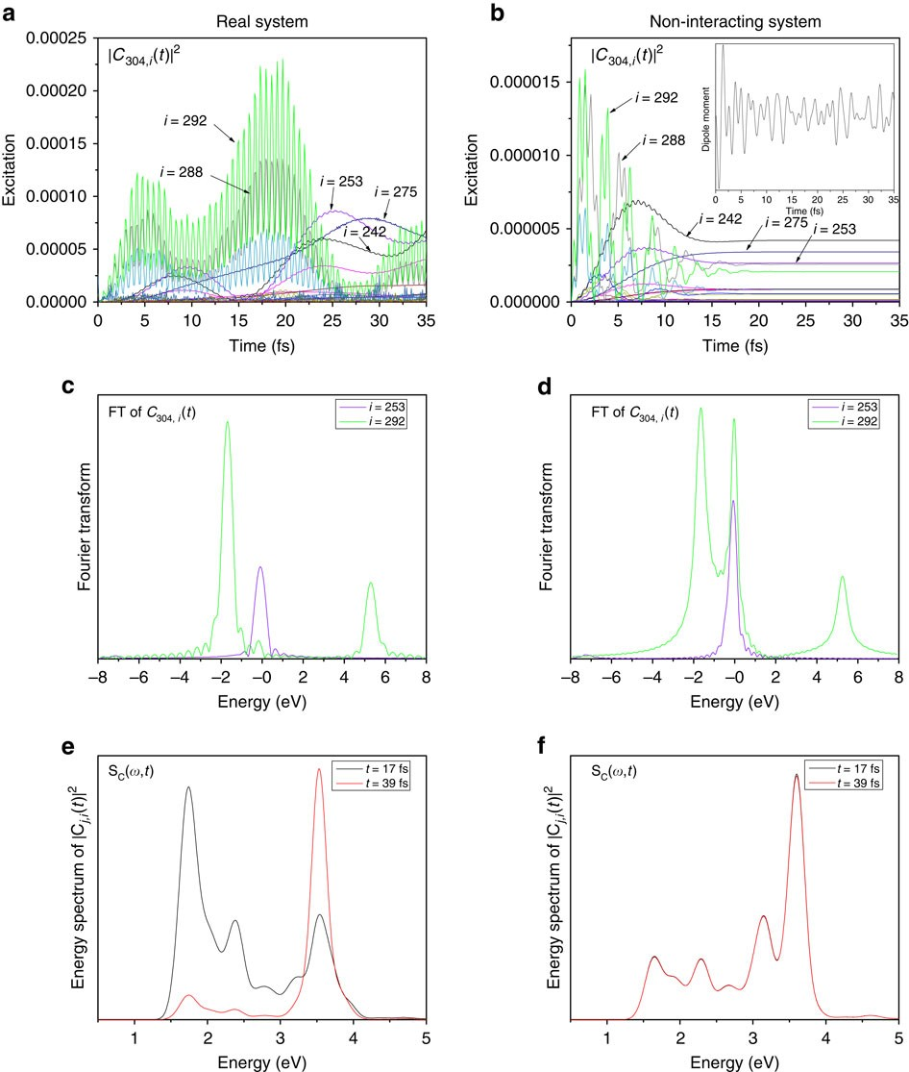
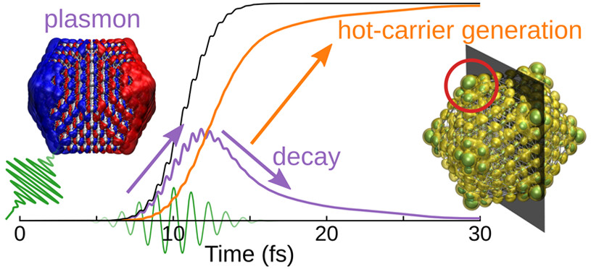
Plasmon decay in silver nanoparticles
Dipole moment
Charge density
Transition coefficients
Nat. Commun., 2015, 6, 10107
Plasmonic energy transferred into single-particle (hot-carrier) excitation
ACS Nano 2020, 14, 9963−9971
Notes:
Time evolution of the energy stored in the excited electronic system. The total energy (black) is divided into the energy of nonresonant electron–hole transition contributions constituting screened plasmon excitation (purple) and that of resonant transition contributions constituting mainly hot carriers (orange).

Slide 5
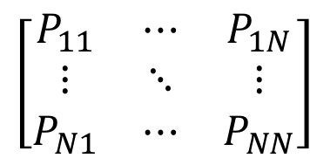
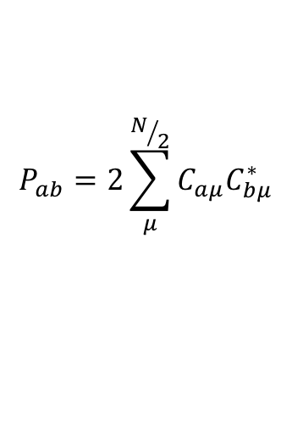
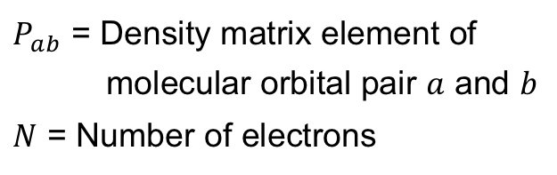
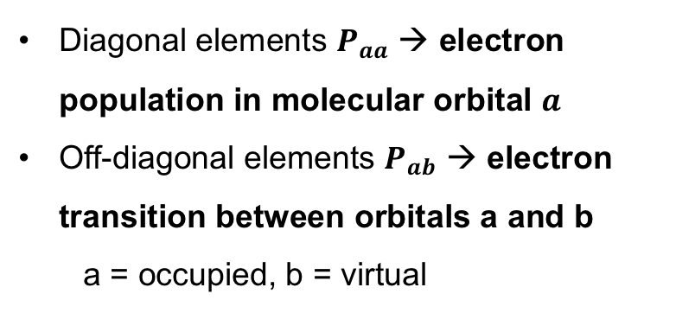
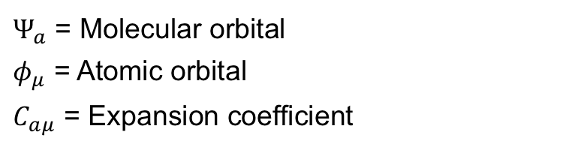
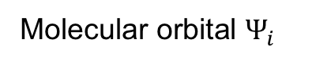
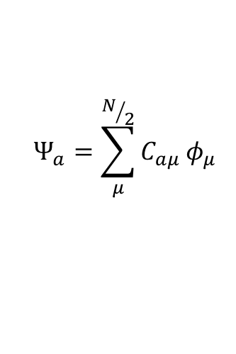
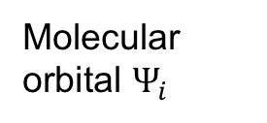
Density matrix (P)
$$Ψ_{a}=\sum_{μ}^{N/2}{C_{aμ}}φ_{μ}$$
$Ψ_{a}$ = Molecular orbital
$φ_{μ}$ = Atomic orbital
$C_{aμ}$ = Expansion coefficient
Molecular orbitals as LCAOs
$$P_{ab}=2\sum_{μ}^{N/2}{C_{aμ}C_{bμ}^{∗}}$$
Density matrix elements
$P_{ab}$ = Density matrix element of
molecular orbital pair $a$ and $b$
$N$ = Number of electrons
Diagonal elements $P_{aa}$ → electron population in molecular orbital $a$
Off-diagonal elements $P_{ab}$ → electron transition between orbitals a and b
a = occupied, b = virtual
Molecular orbital $Ψ_{i}$
Molecular orbital $Ψ_{i}$
$$\left[\begin{matrix}P_{11} & ⋯ & P_{1N} \\ ⋮ & ⋱ & ⋮ \\ P_{N1} & ⋯ & P_{NN}\end{matrix}\right]$$
Magnitude of P_{OV}(t): Amount of electronic transition occurring between the occupied (O) and the virtual (V) orbital at time t.

Slide 6
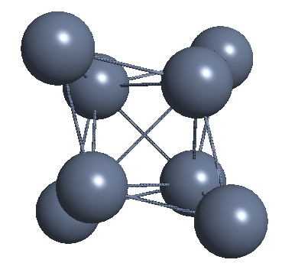
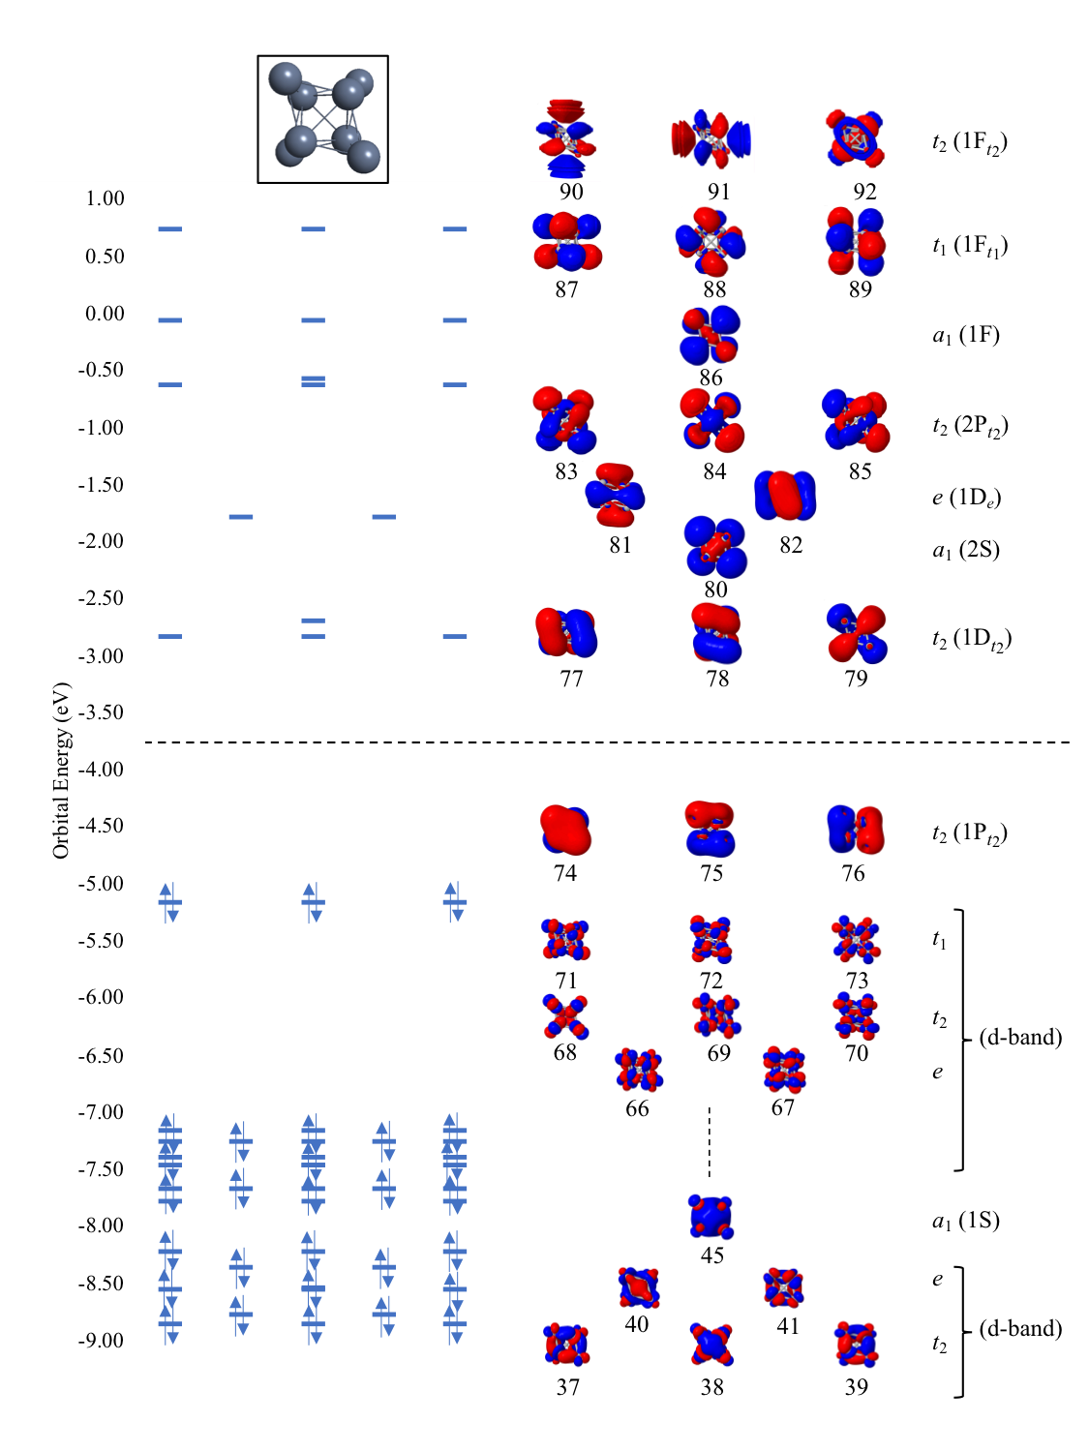
Ag₈ (T_{d}) - Electronic structure and optical properties
Absorption spectrum from LR-TDDFT
1P → 1D
1P → 2S
d-band → 1D
1P → 1D
1P → 2S
Virtual
Occupied
Two sharp peaks at 3.05 eV and 3.96 eV
Constructive contribution of multiple electronic transitions: molecular analog of a plasmon resonance in Ag₈ nanocluster
G. U. Kuda-Singappulige, D. B. Lingerfelt, X. Li, and C. M. Aikens, J. Phys. Chem. C, 2020, 124, 37, 20477–20487
Notes:
5s electrons of Ag atoms fills super atomic orbitals, 1S² 1P⁶
Lower energy excitations; transitions between superatomic orbitals
d-band transitions start to contribute to the higher energy excitations
Collective electron oscillation; Plasmonic

Slide 7
Ag₈ (T_{d}) - Real-time electron dynamics
Trapezoidal-shaped electric field
Excite 3.96 eV state
Observe the dipole response
Maximum strength = 0.001 au (~3.57×10¹³ W/cm²) with a given frequency
Time step = 0.002 fs; Total time = 240 fs
BP86/LanL2DZ level of theory
Development version of Gaussian
G. U. Kuda-Singappulige, D. B. Lingerfelt, X. Li, and C. M. Aikens, J. Phys. Chem. C, 2020, 124, 37, 20477–20487

Slide 8
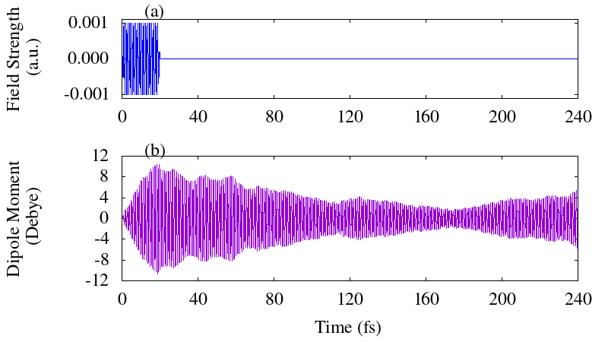
Ag₈ (T_{d}) - Real-time electron dynamics
0-20 fs: Increase
20-175 fs: Decrease
After 175 fs: Increases Again
Can we identify the decay mechanism?
Hypothesis: Electronic Transitions
G. U. Kuda-Singappulige, D. B. Lingerfelt, X. Li, and C. M. Aikens, J. Phys. Chem. C, 2020, 124, 37, 20477–20487

Slide 9
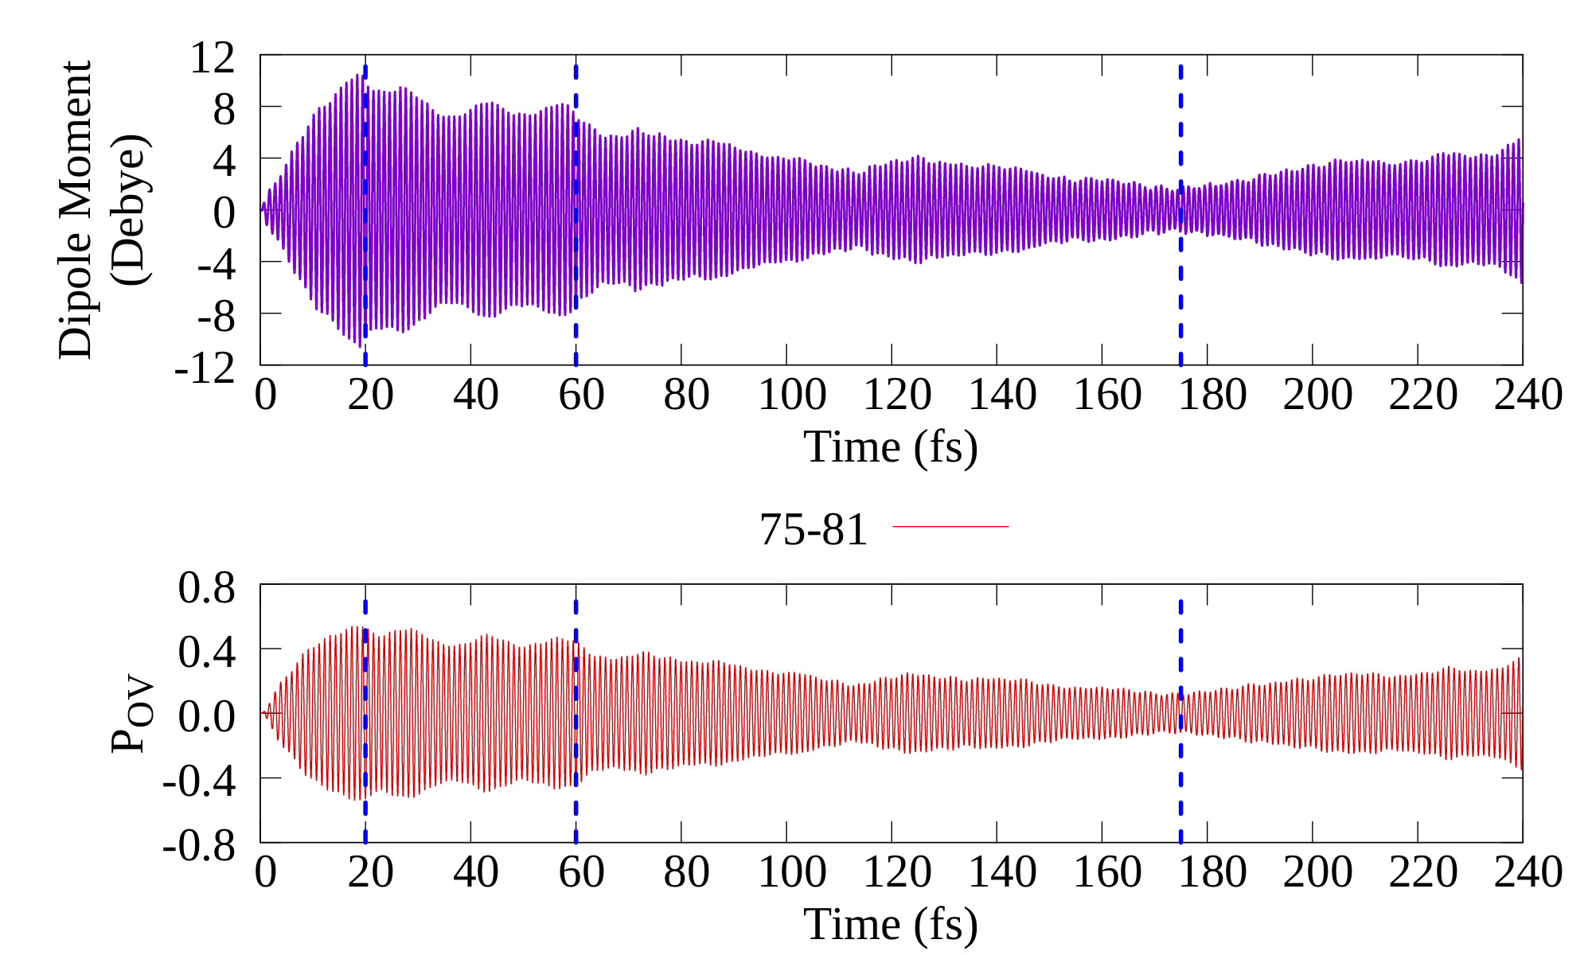
Variation of density matrix elements (P_{ov})
Dipole moment
(1P → 1D)
Off-diagonal elements
Variation of dipole moment dominated by responsible transitions for a given excitation
G. U. Kuda-Singappulige, D. B. Lingerfelt, X. Li, and C. M. Aikens, J. Phys. Chem. C, 2020, 124, 37, 20477–20487

Slide 10
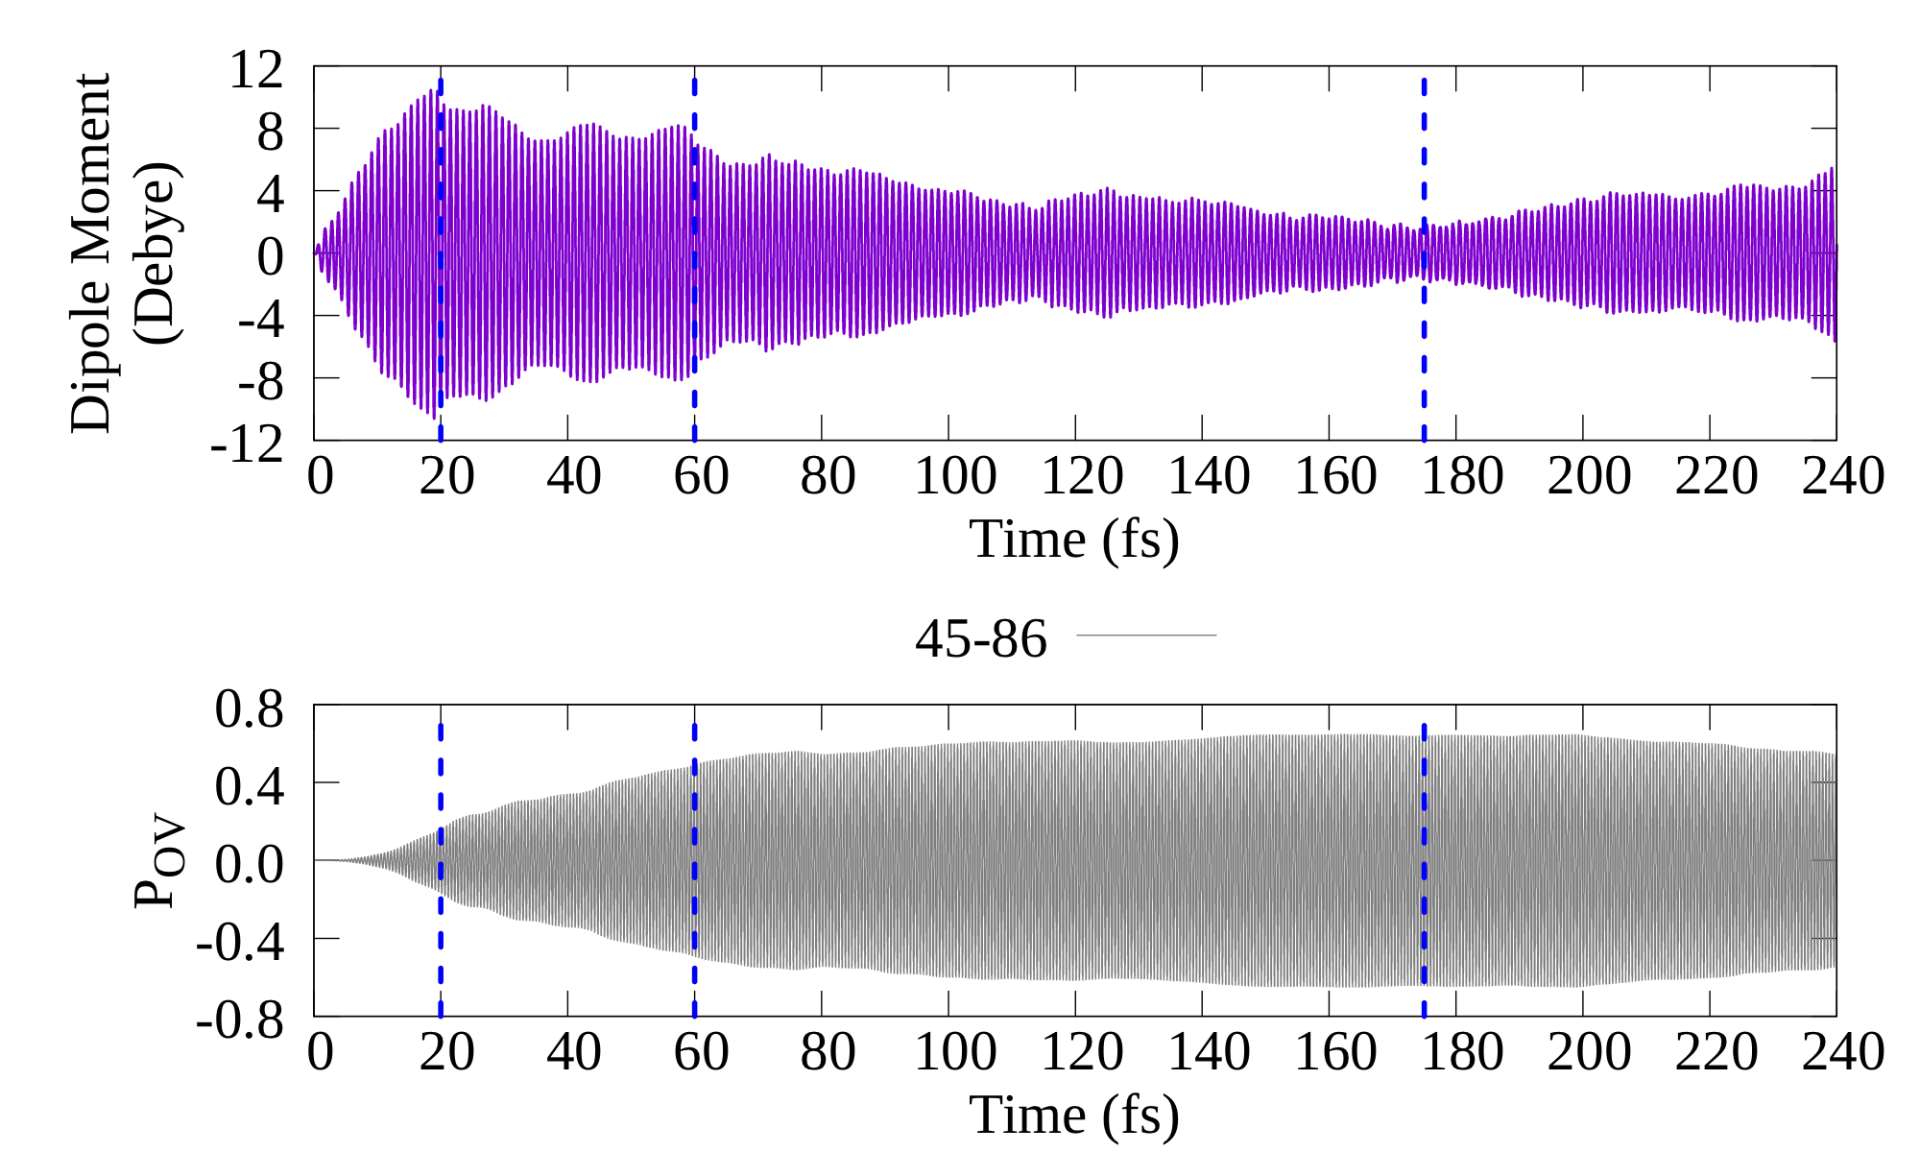
Variation of density matrix elements (P_{ov})
Dipole moment
(1S → 1F)
Off-diagonal elements
Emergence of other transitions that grow even after the field is turned off
G. U. Kuda-Singappulige, D. B. Lingerfelt, X. Li, and C. M. Aikens, J. Phys. Chem. C, 2020, 124, 37, 20477–20487

Slide 11
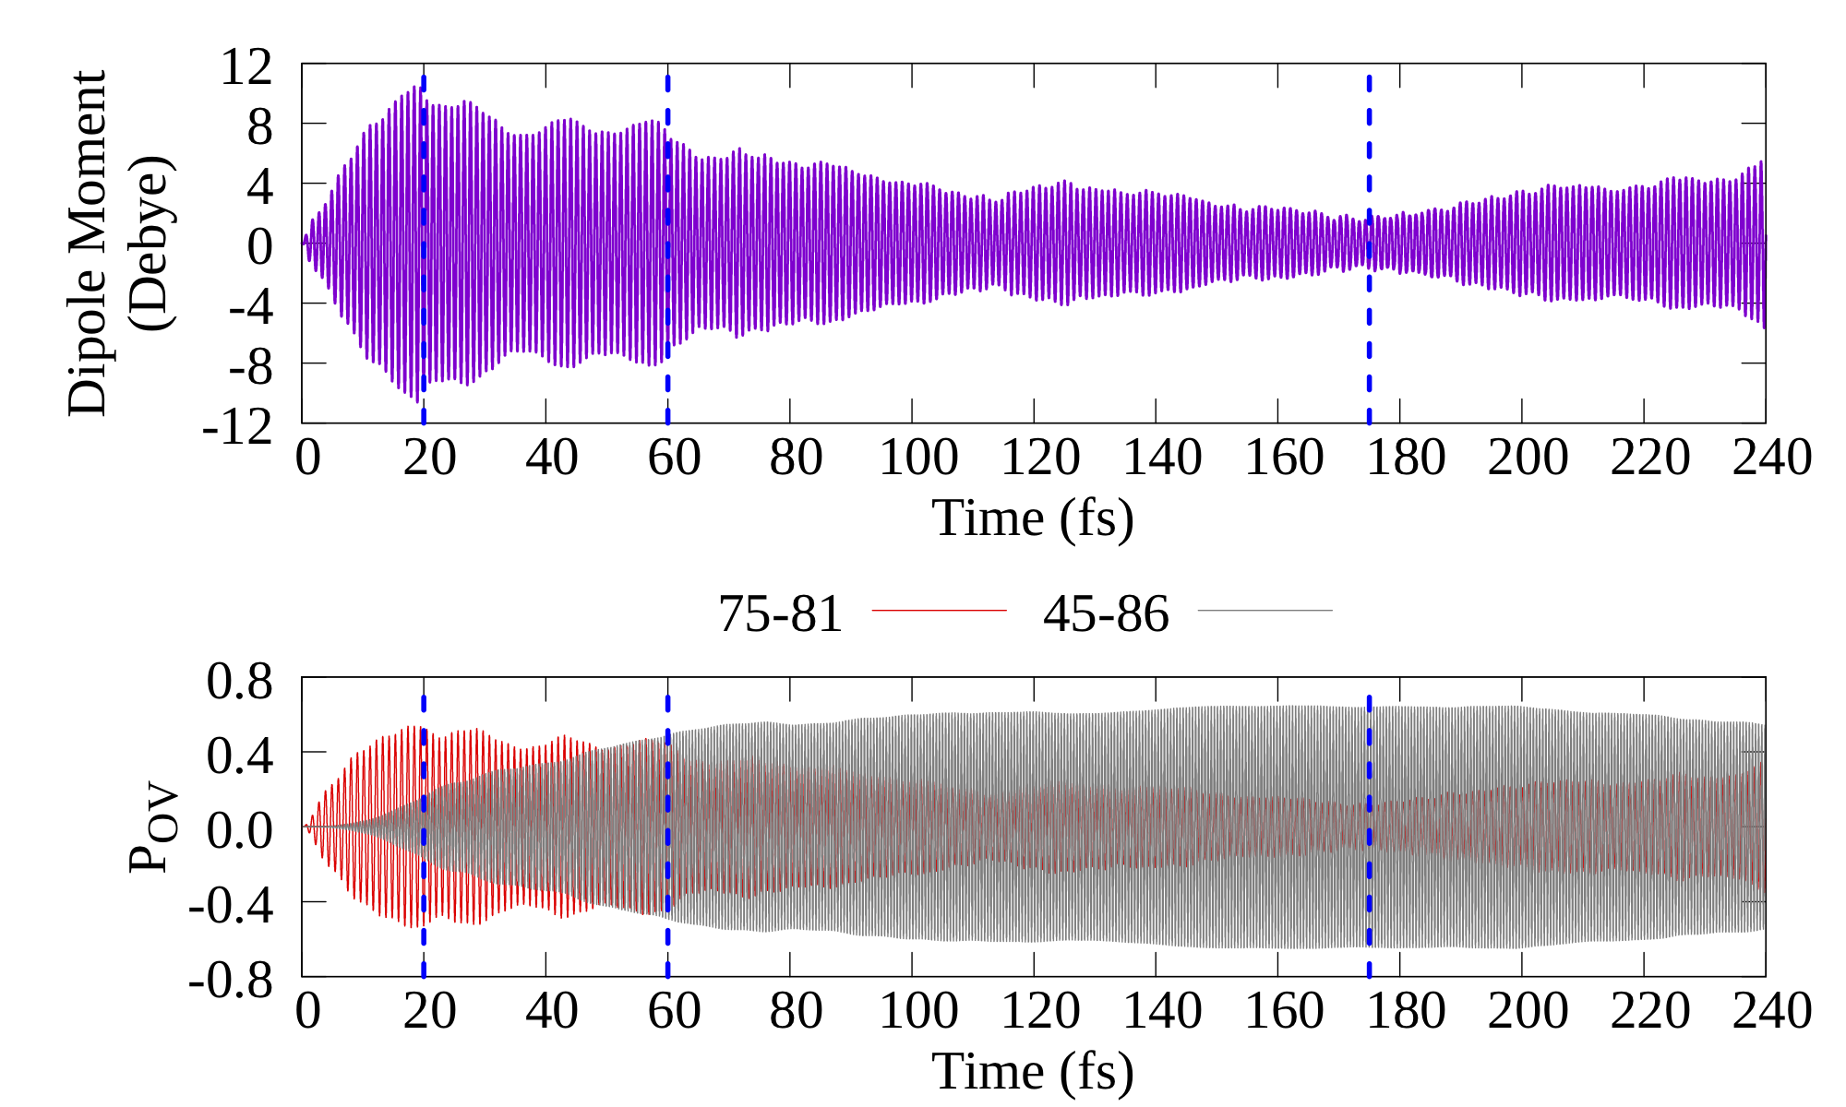
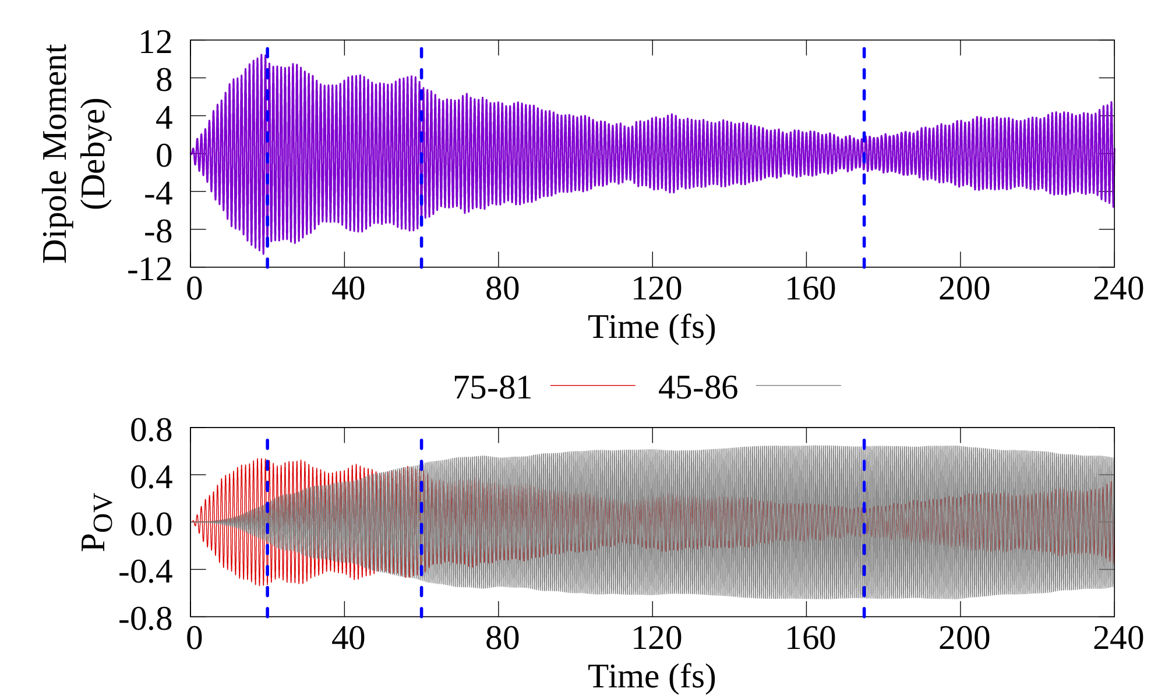
Variation of density matrix elements (P_{ov})
Dipole moment
Fourier transform of P_{ov}
(1P → 1D)
(1S → 1F)
P₇₅₋₈₁: One Photon Absorption (𝝎)
Off-diagonal elements
G. U. Kuda-Singappulige, D. B. Lingerfelt, X. Li, and C. M. Aikens, J. Phys. Chem. C, 2020, 124, 37, 20477–20487

Slide 12
Variation of density matrix elements (P_{ov})
Dipole moment
Fourier transform of P_{ov}
(1P → 1D)
(1S → 1F)
P₇₅₋₈₁: One Photon Absorption (𝝎)
P₄₅₋₈₆: Two Photon Absorption (2𝝎)
Off-diagonal elements
Transitions responsible for the resonant excitation decay into excitations with twice the incident frequency
G. U. Kuda-Singappulige, D. B. Lingerfelt, X. Li, and C. M. Aikens, J. Phys. Chem. C, 2020, 124, 37, 20477–20487

Slide 13
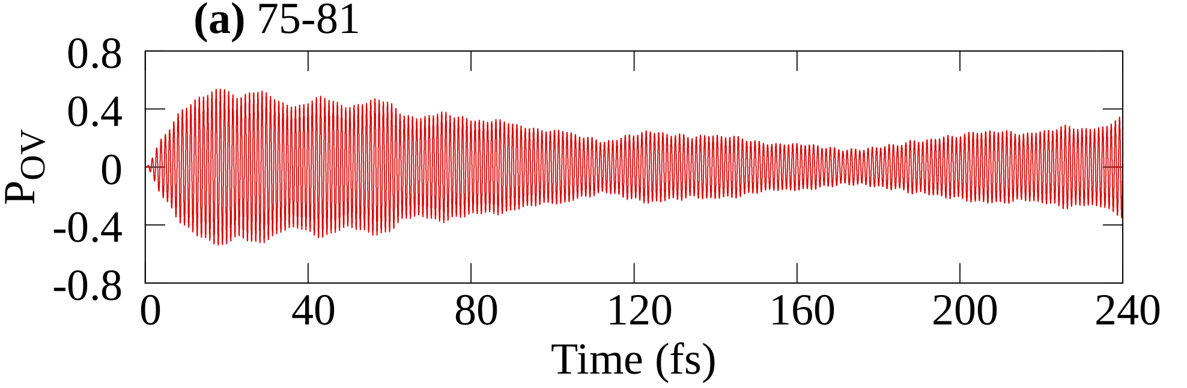
Selection rules - Dipole allowed transitions in T_{D}
If direct product of symmetries of the two orbitals involved in a transition reduced to T₂, the transition is allowed for
One-Photon Absorption
T_{d} | E | 8C₃ | 3C₂ | 6S₄ | 6σ_{d} | linear functions, rotations | quadratic functions
A₁ | 1 | 1 | 1 | 1 | 1 |  | x²+y²+z²
A₂ | 1 | 1 | 1 | -1 | -1
E | 2 | -1 | 2 | 0 | 0 |  | (2z²-x²-y², x²-y²)
T₁ | 3 | 0 | -1 | 1 | -1 | (R_{x}, R_{y}, R_{z})
T₂ | 3 | 0 | -1 | -1 | 1 | (x, y, z) | (xy, xz, yz)
Excitation energy (eV) | Transitions | Spherical assignments | Symmetry | Direct product decomposition into irreducible representation
4.03 | 75 → 81 74 → 81 | 1P → 1D | T₂ → E | T₁ + T₂
 | 76 → 77 | 1P → 1D | T₂ → T₂ | A₁ + E + T₁ + T₂
 | 75 → 80 | 1P → 2S | T₂ → A₁ | T₂
 | 66 → 78 66 → 79 | d-band → 1D | E → T₂ | T₁ + T₂
Transitions contribute to the resonant excited state follow the OPA selection rules
G. U. Kuda-Singappulige, D. B. Lingerfelt, X. Li, and C. M. Aikens, J. Phys. Chem. C, 2020, 124, 37, 20477–20487

Slide 14
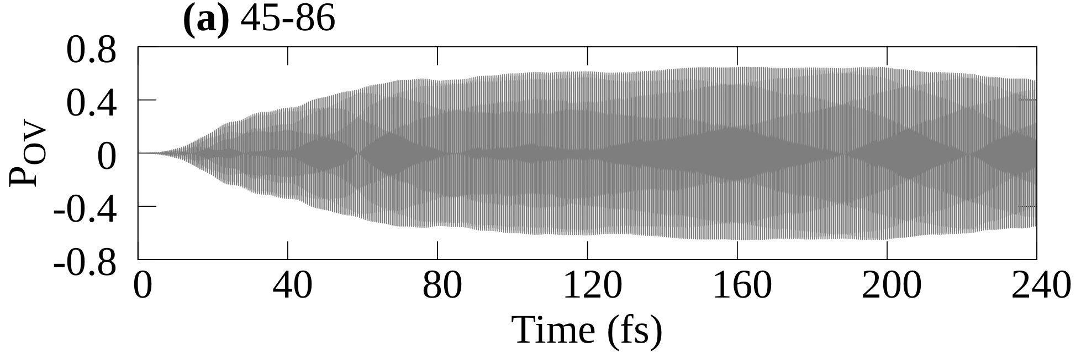
Selection rules - Quadrupole allowed transitions in T_{D}
If direct product of symmetries of the two orbitals involved in a transition can be reduced to A₁, E or T₂, then that transition can be allowed for
Two-Photon Absorption
T_{d} | E | 8C₃ | 3C₂ | 6S₄ | 6σ_{d} | linear functions, rotations | quadratic functions
A₁ | 1 | 1 | 1 | 1 | 1 |  | x²+y²+z²
A₂ | 1 | 1 | 1 | -1 | -1
E | 2 | -1 | 2 | 0 | 0 |  | (2z²-x²-y², x²-y²)
T₁ | 3 | 0 | -1 | 1 | -1 | (R_{x}, R_{y}, R_{z})
T₂ | 3 | 0 | -1 | -1 | 1 | (x, y, z) | (xy, xz, yz)
Excitation energy (eV) | Transitions | Spherical assignments | Symmetry | Direct product decomposition into irreducible representation
8.07 | 45 → 86 | 1S → 1F | A₁ → A₁ | A₁
 | 72 → 92 71 → 90 73 → 90 | d-band → 1F | T₁ → T₂ | A₂ + E + T₁ + T₂
 | 68 → 90 69 → 91 69 → 92 70 → 91 70 → 92 | d-band → 1F | T₂ → T₂ | A₁ + E + T₁ + T₂
Transitions oscillating with 2𝝎 frequency follow the TPA selection rules
G. U. Kuda-Singappulige, D. B. Lingerfelt, X. Li, and C. M. Aikens, J. Phys. Chem. C, 2020, 124, 37, 20477–20487

Slide 15
CONCLUSIONS
Plasmon decay in silver nanoparticles
Energy transferred to excite the transitions with twice the resonant energy
Point group symmetry and frequency analysis of the transitions confirms high energy transitions are due to the two-photon absorption
Energy transfer to activate non-linear properties → A plasmon decay mechanism
Plasmon resonance plays a significant role in enhancing non-linear effects
G. U. Kuda-Singappulige, D. B. Lingerfelt, X. Li, and C. M. Aikens, J. Phys. Chem. C, 2020, 124, 37, 20477–20487

Slide 16

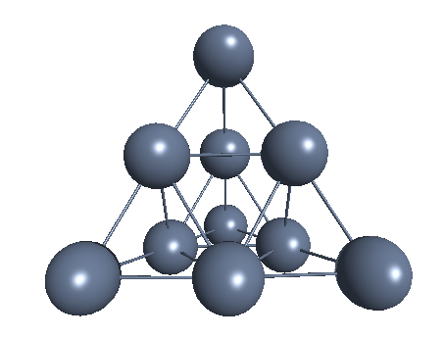
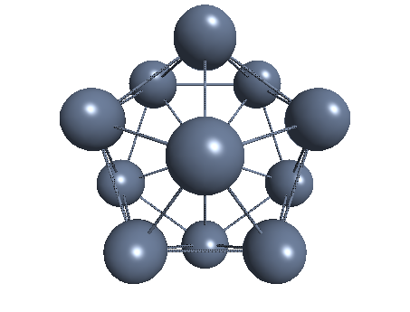
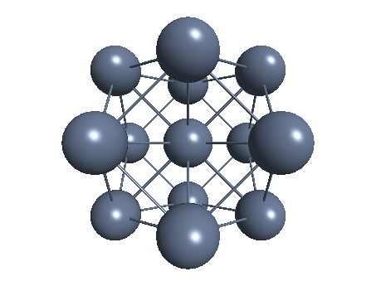
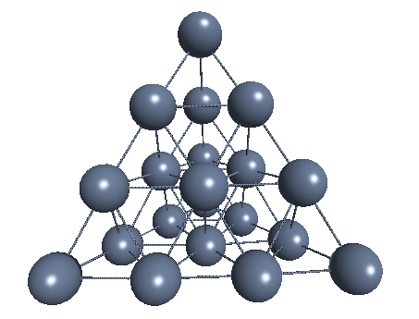
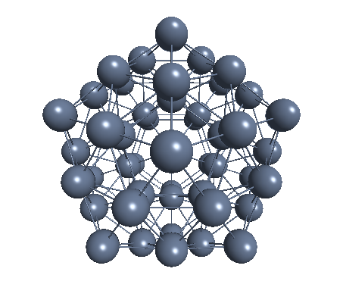
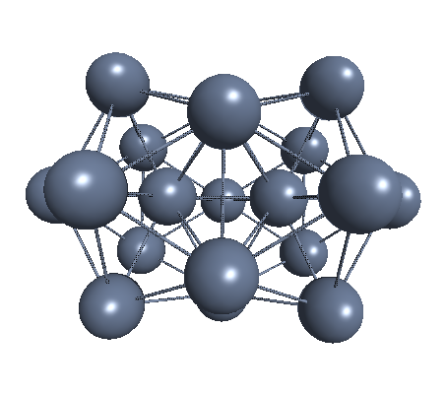
Quantum Dynamics and Beyond:
Symposium in Memory of Donald J. Kouri
Non-linear optical activation in silver nanoclusters as a plasmon decay mechanism
11:45am - 12:00pm USA / Canada - Pacific - April 6, 2021
Gowri Kuda-Singappulige, Presenter | Xiaosong Li | Christine Aikens
Ag₁₀⁺² (T_{d})
Ag₁₃⁺⁵ (I_{h})
Ag₁₃⁻¹ (O_{h})
Ag₁₉⁺¹ (D_{5h})
Ag₂₀ (T_{d})
Ag₅₅⁻³ (I_{h})

Slide 17
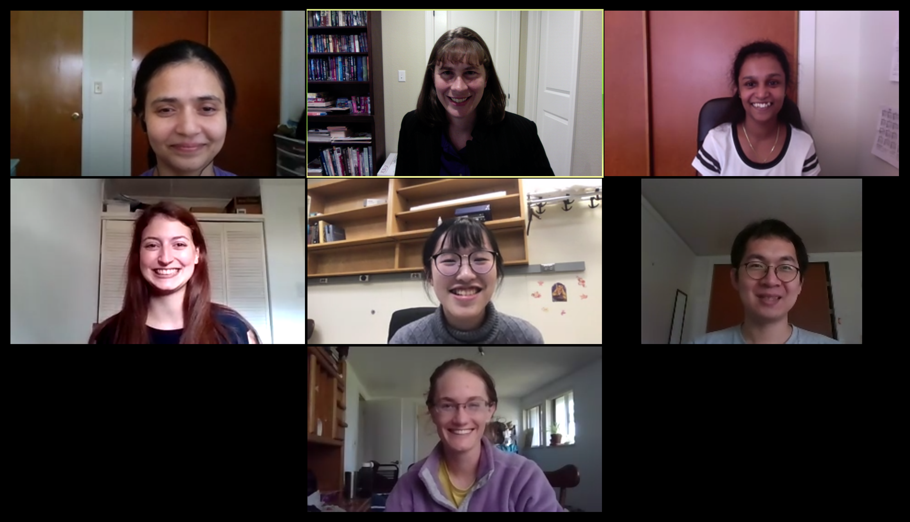





Acknowledgements
Prof. Xiaosong Li
Dr. David Lingerfelt
Andrew Wildman
at University of Washington
Prof. Aikens
Aikens and Liu group members
Thank you !
Department of Chemistry
Kansas State University

